Slide 1
MIT COVID-19 Datathon
// Is Social Distancing a Privilege? //
Track C: Disparities in COVID-19 Health Outcomes
Team 006
Notes:
Hi everyone,
My name is Mikiko and I’ll be presenting on the behalf of Team 6.
For this datathon, we decide to explore the question of “Whether Social Distancing is a privilege?”
And in this context, we define privilege as
“Unearned access to resources (social power) that are only readily available to some people because of their social group membership”

Slide 2
Research Question
Exploring the Relationship between Socioeconomic Status and Social Distancing in the United States
Notes:
COVID-19 is not egalitarian.
Research suggests socioeconomic status affects COVID-19 infection rates¹ and severity^{2,3}.
Given that social distancing reduces COVID-19 transmission rates^{4,5}, does potential observance of social distancing vary by socioeconomic status?
If so, social distancing may be simultaneously “flattening the curve” and catalyzing disparities in COVID-19 related mortality & morbidity.

Slide 3
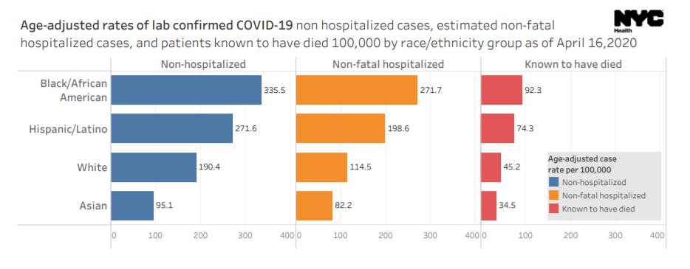
Disparities in Health Outcomes
Source: NYC Health

Slide 4
Public Policy Significance
If social distancing is failing to protect higher risk populations, then public policy solutions are called for.

Slide 5
Hypothesis: The capacity for social distancing varies by socioeconomic status and demographic factors.
Where it is established in the literature that social distancing affects infection rates.
Notes:
There is pending research study on whether social distancing varies by socioeconomic status: https://www.medrxiv.org/content/10.1101/2020.04.06.20055632v1.full.pdf
We could go with race and socioeconomic status to distinguish ourselves, maybe? Or just have two studies out there.
There is a distinction between the ability to socially distance and the performance of social distancing (i.e., doing it in practice), with individual behaviours causing the difference between them. But, I'd think, examining that nuance would be difficult to do within the time frame we have.
There are also different data points that are more relevant to each of these things. For example, the Google Mobility data relates more to actual performance of social distancing, whereas the number of people employed in health care (essential workers) or the median income in a county would relate more to the ability to socially distance, because poorer people or essential workers simply do not have the ability to not go to work.
So, in my mind, whether our own work has that assumption would depend largely on which factors we use. If we don't use mobility data, for example, and focus on demographic factors alne, then we're not really looking at who is and isn't performing social distancing. Thus, the assumption would not necessarily be inherent within our model. Alternatively, even if we do use mobility data, it is a fair assumption that those who don't socially distance are likely to be unable to do so, and we can leave that as something that future research should focus on. Ultimately, as Mikiko mentioned on the call, we can't exactly pull off an entirely academically rigorous study which addresses and proves literally every assumption we make in less than a week.

Slide 6
Understanding Why - the Logic
Socioeconomic Factors
Social Distancing
Health outcomes and infection rates
Data analysis
Literature review
Independent
Intermediate outcome
Dependent
Notes:
Our goal in this project wasn’t to re-establish the link between observing social distancing on an individual’s health outcomes as reserachers have already done a great job in this area.
Instead our goal is to understand the socieconomic factors that impact an individual’s ability to observe social distancing.

Slide 7
Methodology
Social Distancing Index
Variance in SDI
A means of quantifying social distancing
Socioeconomic status data (ability)
+ Mobility data (behavior)
Use multivariate regression:
The importance of different socioeconomic factors with regard to one’s capacity to socially distance.
Notes:
So our methodology was as follows: Given we cannot directly observe an individual’s behavior, we decided to try and proxy, using Social Distance indexes that have already been published.
Once we were able to recreate these indexes to the bst of our ability, we would then use multivariate regression

Slide 8


Social Distancing Indices (SDI)
Mobility (behavior)
Socioeconomic (ability)
+
Change in average distance traveled compared to a pre-COVID-19 period (% change over time)
Change in visitation to non-essential venues compared to a pre-COVID-19 period (% change over time )
Encounter Density (% of baseline aka ratio)
Homes: Overcrowded housing (% of residents living in homes with more than one person per room)
Neighborhoods: Population density (residents per square mile)
Workplaces: Essential jobs (% of residents who work in one of 10 job categories).
Source: Emily Johnson @ CHI
Notes:
Where the data come from
Which variables we pulled in
Data cleaning
What was the calculation

Slide 9
Data Processing - Reproducing A New SDI
1. Google mobility data
1. Tenure by occupants per room
2. Total population by county
2. Racial makeup by county
3. Essential workforce
Data sources: Google & ACS
Data source: US Census Bureau (ACS)
Master table by county
Calculate social distancing index
Analysis of social distancing index by racial population
Notes:
Features (3 from google mobility; 3 from ACS)
Adopted Unicast methodology (% change on the corresponding days and averaged them out) but mined the google mobility data

Slide 10
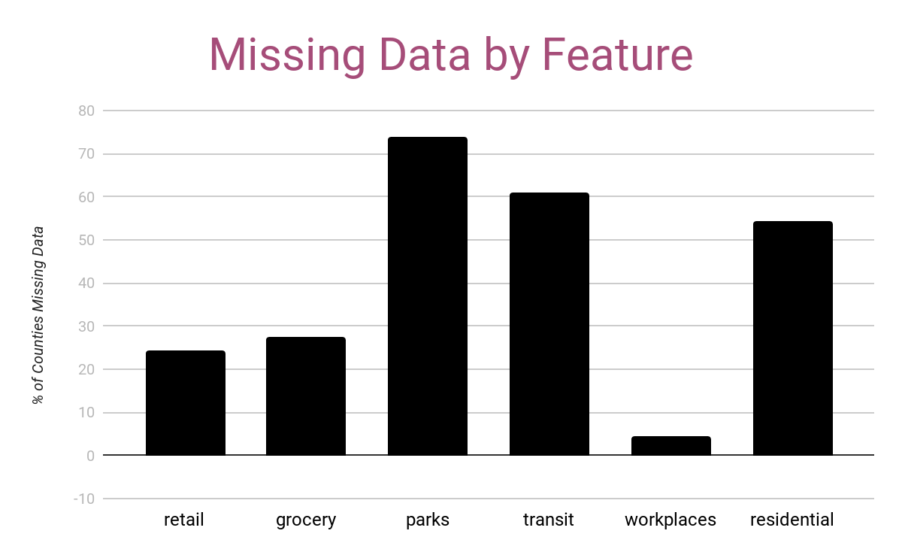
Data Cleaning
“Parks” and “transit” were removed from our analysis
Data was missing at random (MAR)
Missing data in the mobility report was dropped
85% of the original data was kept in the final analysis

Slide 11
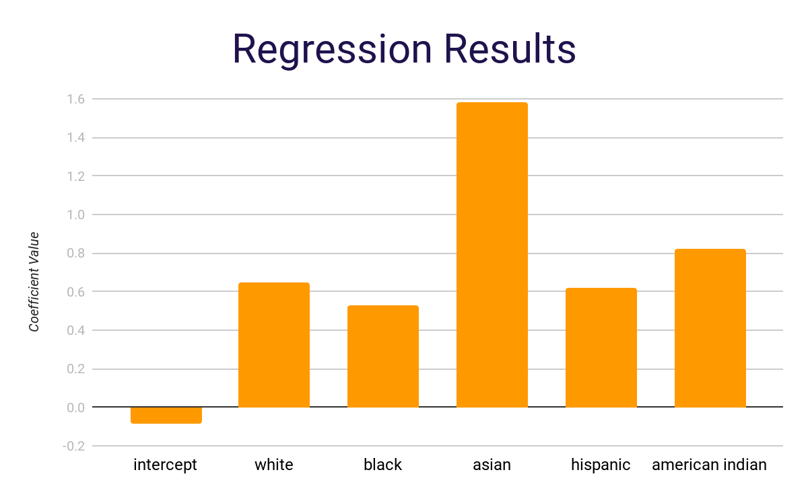
Result - Multivariate Regression
What our analysis showed:
Black population at greatest risk
Hispanic
White
Asian
Notes:
What our analysis showed:
Hispanic at greatest risk
Black
White
American Indian
Asian at lowest risk -
Important notes
Population counts:
Others < less than 1% of the population

Slide 12
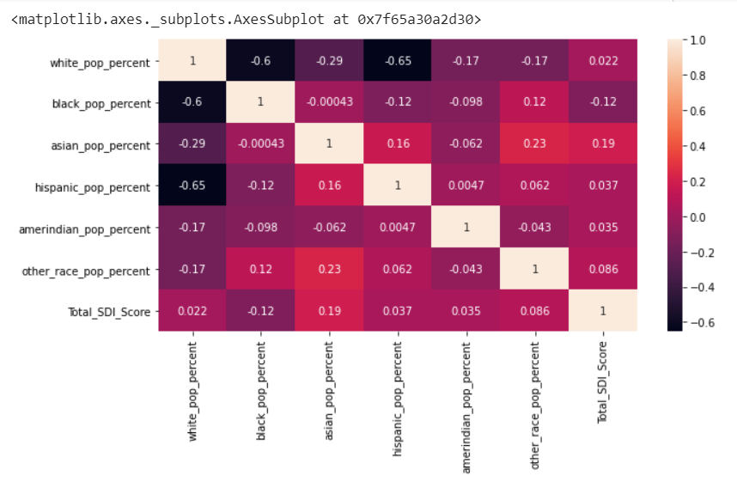
Result - Correlation Matrix

Slide 13
Future Research
Data Collection:
Additional data enrichment around mobile location data
Statistical tools:
Decomposition Regression Analysis

Slide 14
Challenges Facing Different Subpopulations
Nearly 25% of currently employed Hispanic and Black or African American workers are employed in service industry jobs, compared to 16% of non-Hispanic whites.
Black or African Americans make up 12% of all employed workers, but account for 30% of licensed practical and licensed vocational nurses.
Hispanic workers have lower rates of access to paid leave than white non-Hispanic workers.
Multi-generational households, which may be more common among some racial and ethnic families, may confront space and caregiving challenges that impede social distancing.
Those in the lowest income brackets report a significantly lower perceived risk of exposure than those in the highest income groups
Notes:
https://healthpolicy.usc.edu/evidence-base/individuals-with-low-incomes-less-education-report-higher-perceived-financial-health-threats-from-covid-19/
https://www.cdc.gov/coronavirus/2019-ncov/need-extra-precautions/racial-ethnic-minorities.html

Slide 15
OUR DEEP APPRECIATION FOR
Team MIT
Our Mentors:
Shahzad Amjad Khan
Frank Kuchinski
Andrew Marshall
Arjumand Siddiqi
Michael Williams
The Datathon Sponsors

Slide 16






Team
Eleanor Dehoney
Ian Yen
Mikiko Bazely
Tashi T. Gurung
Shreyansh Bardia
Muhammad Jarir Kanji

Slide 17
Google Colab
Github Repository
https://colab.research.google.com/drive/11I-lQAxkhCS4pCam3u2YMQ3DuDN-eteY?usp=sharing#scrollTo=bUwkeIR3hU7l
github.com/TashiNyangmi/MIT-Challenge-2020

Slide 18
References
1. Kumar, S., Piper, K., Galloway, D. D., Hadler, J. L., & Grefenstette, J. J. (2015). Is population structure sufficient to generate area-level inequalities in influenza rates? An examination using agent-based models. BMC Public Health, 15(1), 947.
2. Elo, I. T. (2009). Social class differentials in health and mortality: Patterns and explanations in comparative perspective. Annual review of sociology, 35, 553-572.
3. The Novel Coronavirus Pneumonia Emergency Response Epidemiology Team. (2020). The epidemiological characteristics of an outbreak of 2019 novel coronavirus diseases (COVID-19)—China, 2020. China CDC Weekly, 2(8), 113-122.
4. Wagner, A. B., Hill, E. L., Ryan, S. E., Sun, Z., Deng, G., Bhadane, S., ... & Acharya, J. (2020). Social Distancing Has Merely Stabilized COVID-19 in the US. medRxiv.
5. Zhang, J., Litvinova, M., Liang, Y., Wang, Y., Wang, W., Zhao, S., ... & Ajelli, M. (2020). Changes in contact patterns shape the dynamics of the COVID-19 outbreak in China. Science.
Special credits to Unacast and Colorado Health Institute for the information about their SDIs

